Slide 1

Final Year Project Presentation on Reward Based Intelligent Garbage System
RAJKIYA ENGINEERING COLLEGE,
SONBHADRA
Presented By:
Group 13
Abhishek Nigam
Vinay Prajapati
Ratnesh Chaudhary
Arhan Shekhar
Anjali Gautam
Guide: Prof. Dr. Dharmendra Dixit
Co Guide: Prof. Mr. Prashant Pandey

Slide 2
OUTLINE
Flow Chart
Circuit diagram
Status of our project.
Future Plans
Future Scope
Cost Analysis
Conclusion
Advantages
Limitations
References
Project Objective
Motivation
Literature Survey and Outcome of Survey
Proposed Design and Method
Block Diagram
Action Plan
Feature of Project
Hardware Part
Web Part

Slide 3
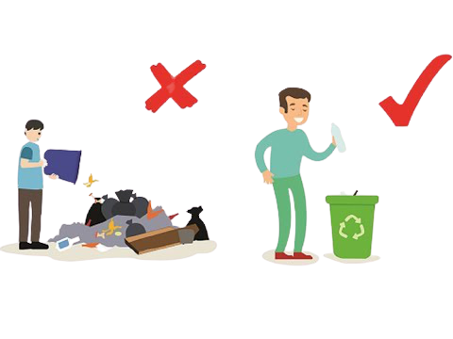

PROJECT OBJECTIVE
People will be tempted so that they do not throw garbage out .

Slide 4
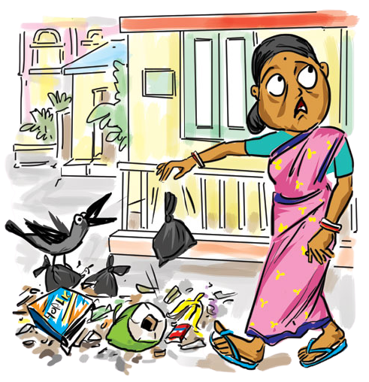
MOTIVATION
We thought this project because most people do not pay attention to cleanliness and throw garbage out.
Which causes lot pollution in the environment as well as many severe diseases.
We are making this project by considering the common human nature that every human being is attracted to those things through which they earn some reward.

Slide 5
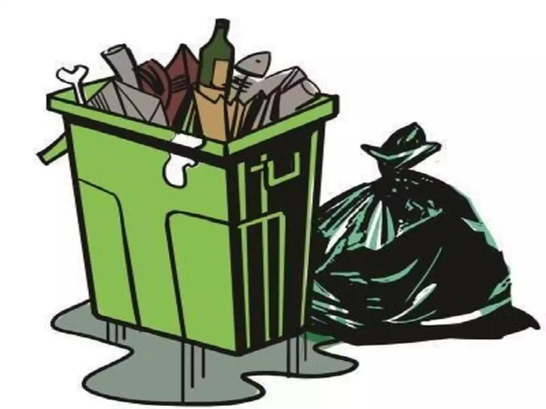
LITERATURE SURVEY
1. Roadside Garbage Dumping system
The garbage system what we have today is a system civilized roadside garbage bin dumping system in which people are advised to put their garbage only in the garbage bin kept at the side of a road.
OUTCOME:
We cannot control the amount of garbage that people put into the garbage bin.
The garbage bin at that place would keep on overflowing with garbage leading to stinking smell and unhealthy environment.

Slide 6
2. Quantitative Analysis of Spatial Pattern of Dustbins and its Pollution in Dhaka City -- A GIS Based Approach
The authors in [1] have made a quantitative analysis between existing dustbins and their serving population. The study first analyses the spatial distribution of dustbins in some areas of Dhaka city using average nearest neighbor functions of GIS. Next, an optimal number of additional dustbins were calculated. It is shown that the number of existing dustbins is insufficient in the study area. The extent of pollution caused by the existing dustbins was calculated using spatial analyst functions of GIS. It is found that all the dustbins are burnt with wastes and causing pollution to the environment.
OUTCOME:
The results thus obtained would help to understand the present situation of the waste management and to optimally place the required number of dustbins to prevent further pollution to environment.

Slide 7
3. IOT BASED WASTE COLLECTION MONITORING SYSTEM USING SMART PHONES
The authors in [2] have equipped the smart bins with ultrasonic sensors which measure the level of dustbin being filled up. The container is divided into three levels of garbage being collected in it. Every time the garbage crosses a level the sensors receives the data of the filled level. This data is further sent to the garbage analyzer as instant message using GSM module.
OUTCOME
This system provide mechanism to display filled level of dustbin, sending notification to driver, finding shortest route to reach the destination, receive complaints from the citizen and display the current location of trucks.

Slide 8
4. IoT-Based Smart Garbage System for Efficient Food Waste Management
The authors in [3]. In an SGS, battery-based smart garbage bins (SGBs) exchange information with each other using wireless mesh networks, and a router and server collect and analyze the information for service provisioning. Furthermore, the SGS includes various IoT skills considering user convenience and increases the battery lifetime through two types of energy-efficient operations of the SGBs: stand-alone operation and cooperation based operation. The proposed SGS had been functioned as a pilot project in Gangnam district, Seoul, Republic of Korea, for a one-year period.
OUTCOME:
Reduction of food waste of about 33%.
Improve the efficiency of food waste management.

Slide 9
PROPOSED SYSTEM
Intelligent part of Dustbin
In this system there are two section for collecting waste i.e. metallic and non-metallic
People easily dump the waste, the Inductive sensor segregate the metallic and non-metallic waste.
If the garbage bin is 75% full then a warning message is sent to officials to vacate it.
Message is received on the Blynk mobile application.
.

Slide 10
2. Reward part of Dustbin
People will get some reward points for every dump of waste.
People have to register online to earn reward points.
After registration people would get smart card i.e. RF-tag whose ID is linked with the bin.
Users have to flash the smart card (RFID CARD) on the card reader of the garbage bin to access their account for garbage deposition.
After dumping the garbage the verified user will easily get his reward point.

Slide 11
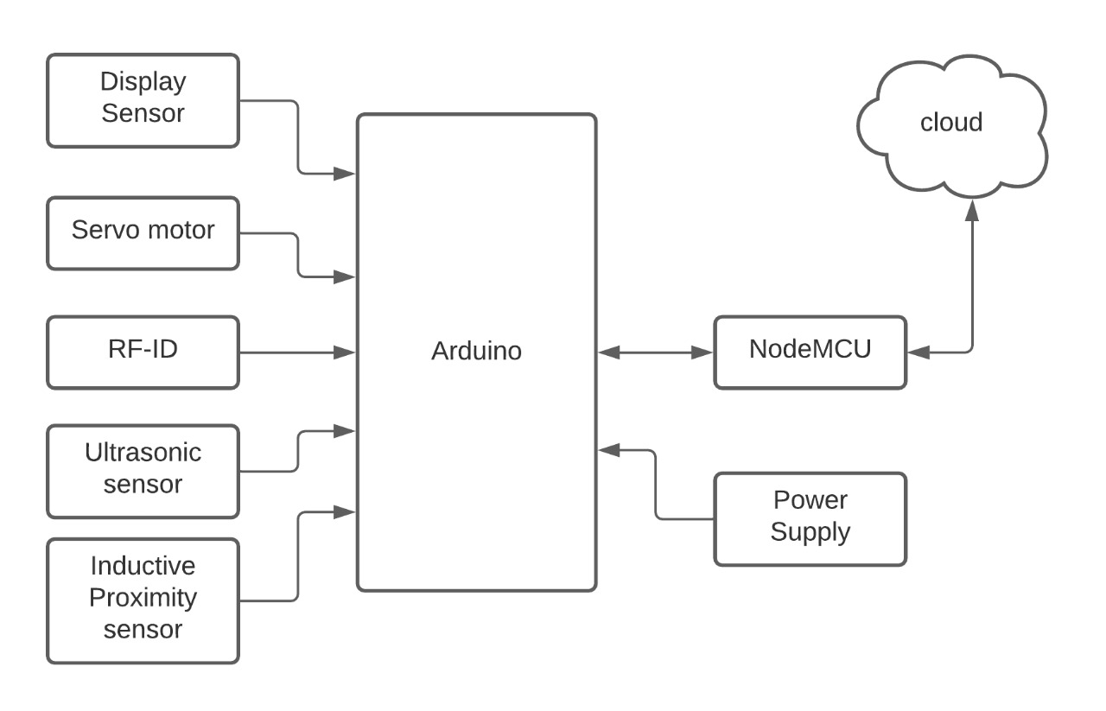
BLOCK DIAGRAM

Slide 12
ACTION PLAN
THERE ARE THREE SECTION IN DUSTBIN
FIRST SECTION
The card reader on the dustbin scan the RF-ID then servo motor open the lid of the dustbin.
SECOND SECTION
The inductive sensor check the type of garbage i.e., metallic or non-metallic and it segregate it with the help of another servo motor.
THIRD SECTION
Storage of waste. When the bin gets 75% full, then a alert notification would sent to the officials by NodeMCU with the help of Ultrasonic sensor.
The Rf-Id tag would give access to the verified user to earn reward point.
The reward points will reflect on the RBIGS portal.

Slide 13
FEATURE OF PROJECT
There are various FEATURES of our project. It can offer number of advantages to the people. Our project has some of the most countable features that have mentioned below :-
It will be fully automatic without human interface.
Whoever needs to dump the garbage will have one Rf-Id using which they can earn rewards points.
They can redeem their rewards points, in form of coupon discount etc.

Slide 14
PROJECT PART
Hardware Part
Web Part
This part of project consist of electronics circuitry and all the electronics devices.
This part of project will take care people data and anyone can see their rewards points.

Slide 15
HARDWARE PART
Arduino UNO
Lcd
Node MCU
Servo Motor
RF-ID Reader and Tags
Ultrasonic sensor
Inductive Proximity Sensor

Slide 16
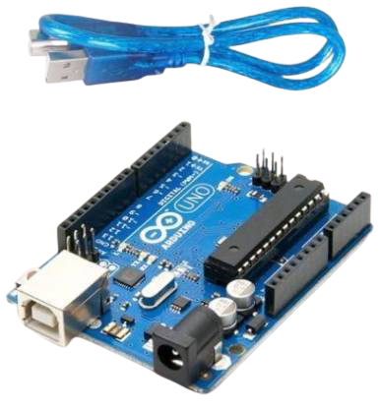
ARDUINO UNO
Arduino UNO is based on an ATmega328P microcontroller. It is easy to use compared to other boards, such as the Arduino Mega board, etc. The board consists of digital and analog Input/Output pins (I/O), shields, and other circuits.
It is an open-source physical computing platform.
It is programmed in Arduino Programming language(APL) similar to C/C++.

Slide 17
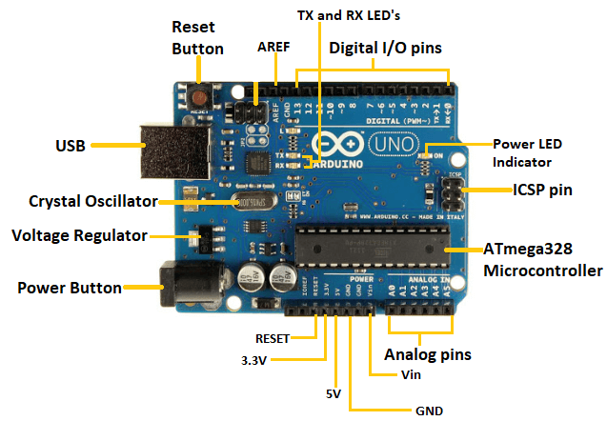
FEATURES
Processor: 16 MHz ATmega328.
Ram:2kb.
Operating Voltage: 5V.
Input Voltage: 7-12V.
Number of Analog inputs: 6.
Number of Digital I/O 14
DC Current per I/O Pin: 40 mA
DC Current for 3.3V Pin: 50 mA

Slide 18
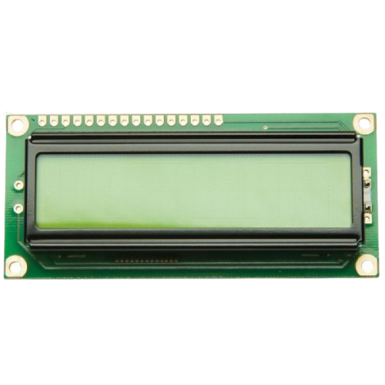
LCD
A Liquid Crystal Display (LCD) is a thin , flat panel display device used for electronically displaying information.
Power Supply pins (Vss/Vcc): Power the LCD
Contrast pin (Vo): Control the display contrast
Register Select (RS) pin: Controls where in the LCD's memory you're writing data to
Read/Write (R/W): Selects reading mode or writing mode

Slide 19
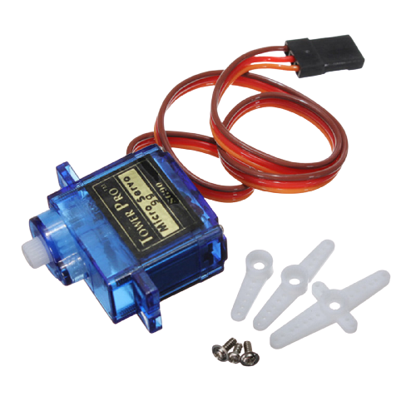
SERVO MOTOR
Servo Motor helps in opening the lid of the dustbin.
The Arduino is programmed in such away that after detecting the waste using ultrasonic sensor the lid should open automatically and this is done using this servo motor.

Slide 20
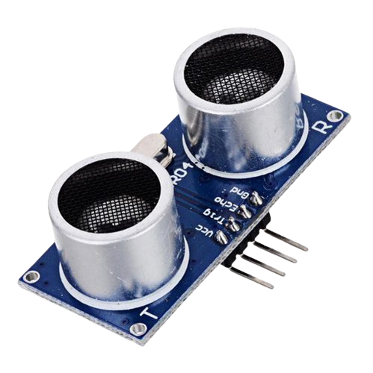
ULTRASONIC SENSOR
An ultrasonic sensor is an electronic device that measures the distance of a target object by emitting ultrasonic sound waves, and converts the reflected sound into an electrical signal.
Ultrasonic sensors use sound waves (echolocation) to measure how far away you are from an object.

Slide 21
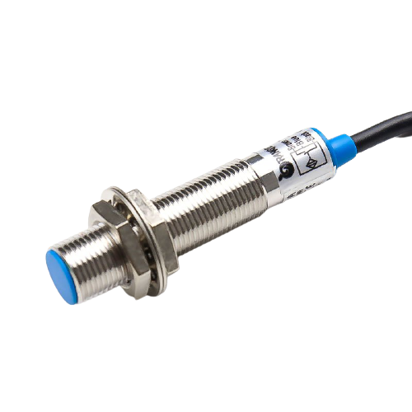
INDUCTIVE PROXIMITY SENSOR
Inductive proximity sensor is a non-contact electronic proximity sensor. It is used for positioning and detection of metal objects. The sensing range of an inductive switch is dependent on the type of metal being detected.
This will use for segregation waste.

Slide 22
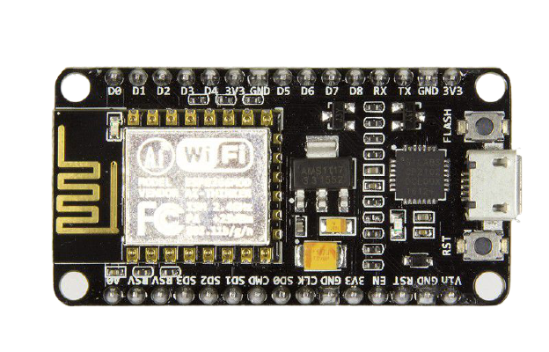
WiFi Module - ESP8266
ESP8266 is an open source IoT platform. This is used for making the things work using Wi-Fi.
ESP8266 is an open-source Lua based firmware and development board specially targeted for IoT based Applications.
Here we will use this to send users and other data to web.

Slide 23
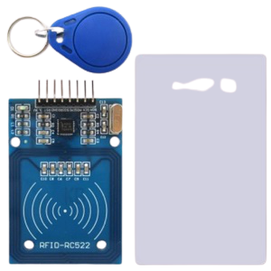
RF-ID READER AND TAGS
Radio Frequency Identification (RFID) is a technology that enables wireless short- and medium- range tracking and identification of objects.
Radio Frequency Identification (RFID) is the wireless non-contact use of radio frequency waves to transfer data
Tagging items with RFID tags allows users to automatically and uniquely identify

Slide 24
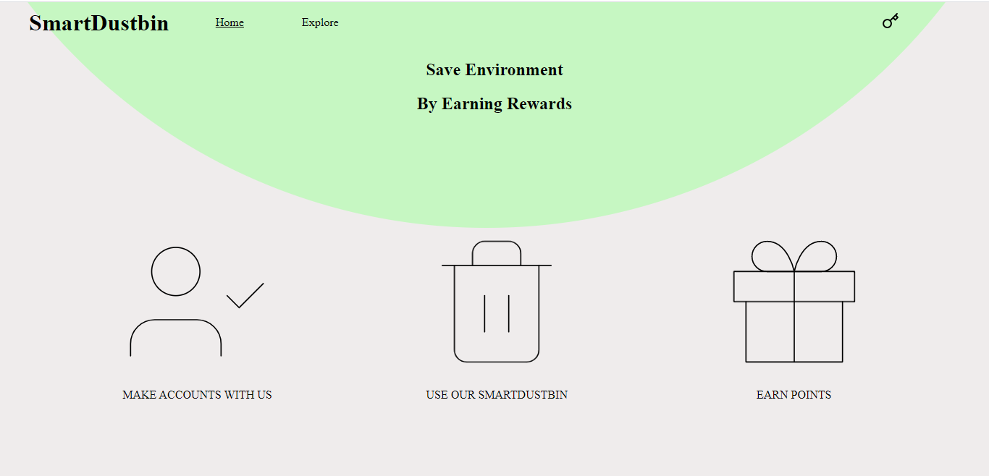
WEB PART
Pages on Web
Login/Signup
New can Register with there Rf-Id
Existing user can see there points
Explore
Here we show top Points earner list
Points
Here user can redeem their points
Profile
Here user can update their name, email, number and rf-id

Slide 25
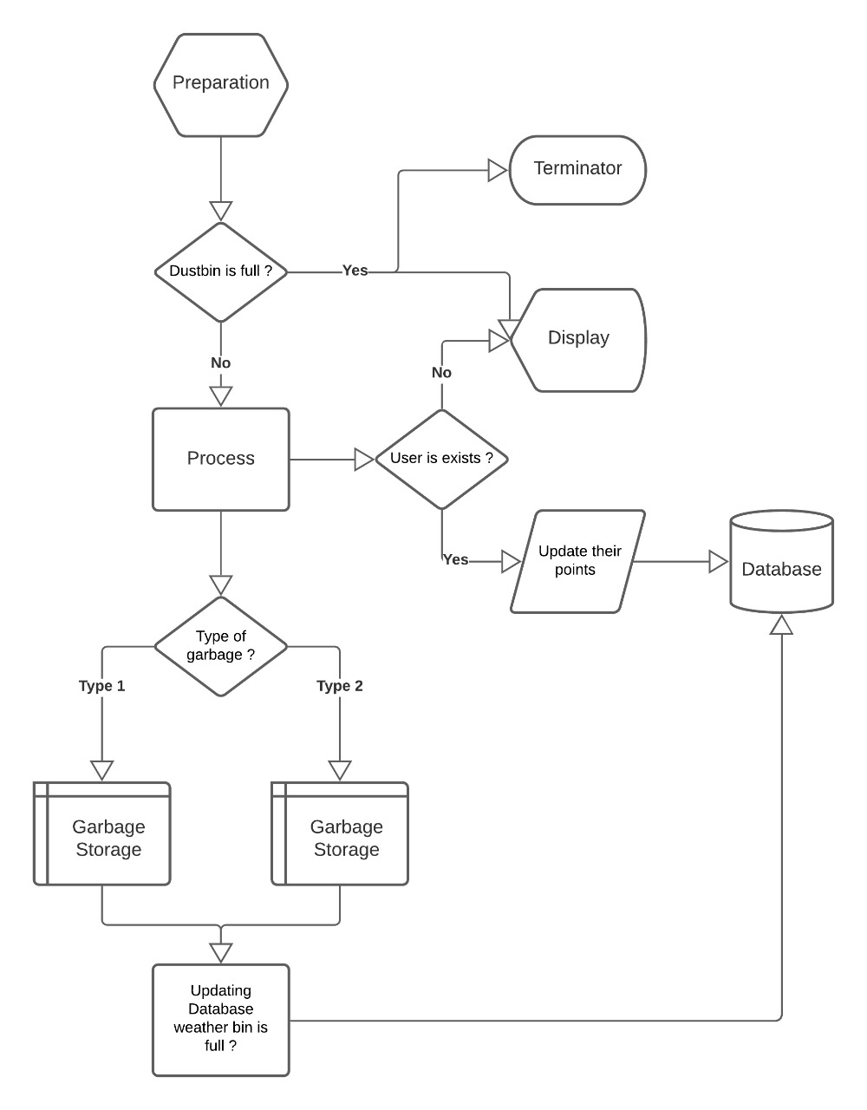
FLOW CHART

Slide 26
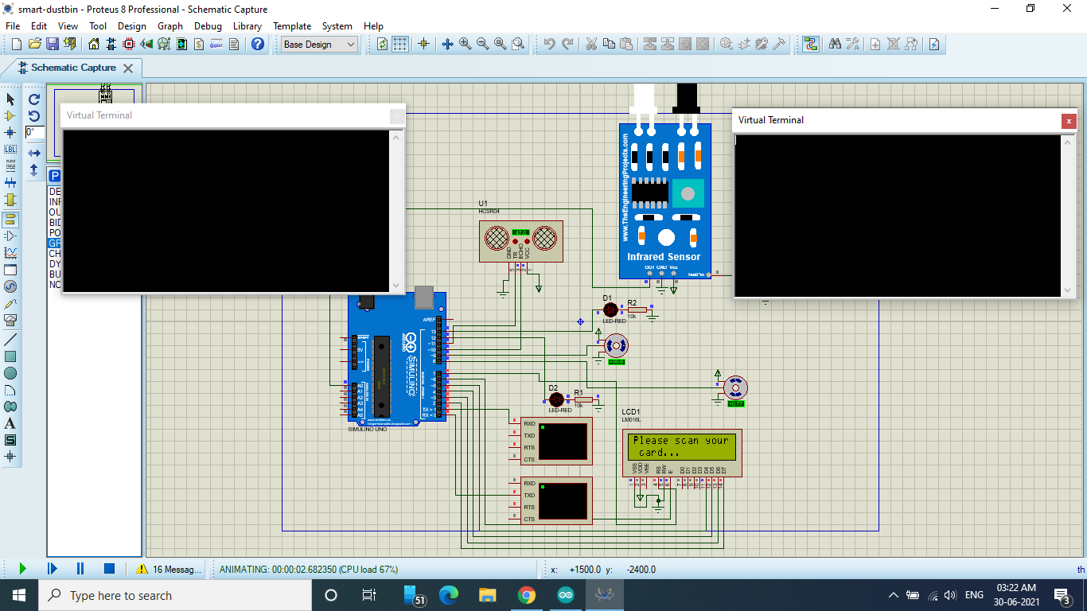
CIRCUIT DIAGRAM

Slide 27
FUTURE SCOPE:
This project is made for demo concern, it can be taken to product level.
Cloud Platform and Raspberry Pi can be used for Data Storage and Data Analysis.
Daily Produce of waste can be monitored.
Currently this dustbin would be made for locally used but after some modification
We can also implement it for globally usable.

Slide 28
STATUS OF PROJECT
Theory work of this project has been completed.
Mostly software part like simulations has been completed.
FUTURE PLAN
As soon as the COVID situation of our state gets relaxed, our group will meet and implement the project together.
We are planning to make it movable by planting battery in it.
In future we are planning to make segregation of all type of wastes.
We also planning to monitor the type of wastes.

Slide 29
COST ANALYSIS
S.N | Item Names | Cost
1 | Arduino UNO | ~518.00 Rs
2 | Lcd | ~92.00 Rs
3 | NodeMCU | ~204.00 Rs
4 | Servo Motor | ~73.00 Rs
5 | RF-ID Reader and Tags | ~149.00 Rs
6 | Ultrasonic sensor | ~33.00 Rs
7 | Inductive Proximity Sensor | ~153.00 Rs
 | Total | ~1,222.00 Rs

Slide 30
CONCLUSION
Rewards based Intelligent garbage system will attract people so that they will not throw garbage outside anywhere atleast they will use dustbin in sake of some reward points.
We think most of the young generation will attract more towards this dustbin as they get reward for just dumping garbage in dustbin.
The main aim of ​​this project is that people should aware about cleanliness and make the society clean and healthy.

Slide 31
ADVANTAGES
People motivated to put their garbage only in the garbage bin.
We can eliminate waste overflow.
The monitoring of the waste level in the garbage can could be done remotely with a simple browser or an installed software effectively.
The reward system will encourage people for their active participation.

Slide 32
SOME LIMITATIONS OF THIS PROJECT
We know you must be thinking that money will come from where ?
We have few ideas :
We will provide donation links on the web portal.
We will charge fine if someone throws outdoor trash with in some fixed range.
Can also take help of the government.
Also sensors may be damage if someone liquid waste.
There are lot of people in our society which are not much technical aware they might be face problem while using this dustbin.

Slide 33
REFERENCES
[1]. Alexey Medvedev, Petr Fedchenkov, ArkadyZaslavsky, Theodoros,
Anagnostopoulos Sergey Khoruzhnikov,‖Waste Management as an IoT-Enabled Service in Smart Cities‖.
[2]. Meghana K C, Dr. K R Nataraj,‖ IOT Based Intelligent Bin for Smart Cities‖.
[3]. KasliwalManasi H., SuryawanshiSmitkumar B, A Novel Approach to Garbage
Management Using Internet of Things for Smart Cities‖.
[4]. Vishesh Kumar Kurrel,‖ Smart Garbage Collection Bin Overflows Indicator using
Internet of Things

Slide 34
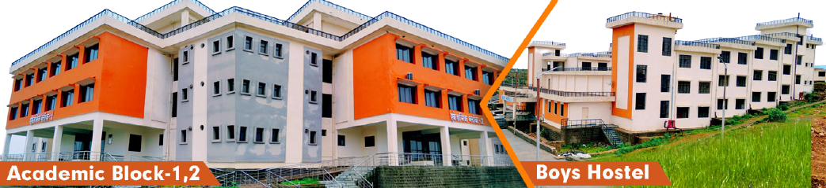
Thanks !!!
Rajkiya Engineering College, Sonbhadra

